Slide 1
Developer Training
The Component Library

Slide 2

Agenda
Introduction
Where is the Component Library
What is included in it?
Components in detail
Layouts in detail
Wrappers in detail
Templates in detail

Slide 3
Introduction

Slide 4
Introduction
The Component Library is
  A set of templates and library classes that help you build templates using little or no code.
  A framework built on top of the underlying CMS templating mechanism – it does not introduce any new APIs or systems.

Slide 5
Key Objectives
Markup-oriented rather than code-oriented.
Use hierarchical composition of components from sub-components.
Use code generation to automate routine implementation artefacts.
Set up the foundations for drag-and-drop content authoring.

Slide 6
Components vs Widgets
Components
Fragment of content pattern
Shared code
Widgets
Fragment of content
Shared content
Can be implemented using components

Slide 7
What is included in the Component Library?

Slide 8
What is included in the Component Library?
CL provides facilities for developers to create four types of definitions:
Component definitions;
Layout definitions;
Nav Wrapper definitions; and
Template definitions.

Slide 9
What is included in the Component Library?
CL translates these definitions into elements in the project folder.
Component definitions | → | C# class files that contain all the input, output and post-input code for the component.
Layout definitions | → | Used as layout controls in the nav wrapper and template definitions
Nav wrapper definitions Template definitions | → | DXM templates that use the generated component classes.

Slide 10
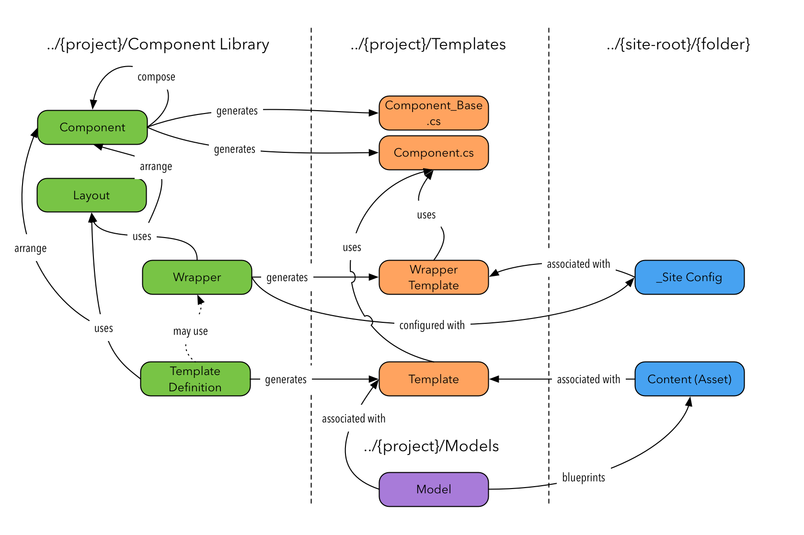
What is included in the Component Library?

Slide 11
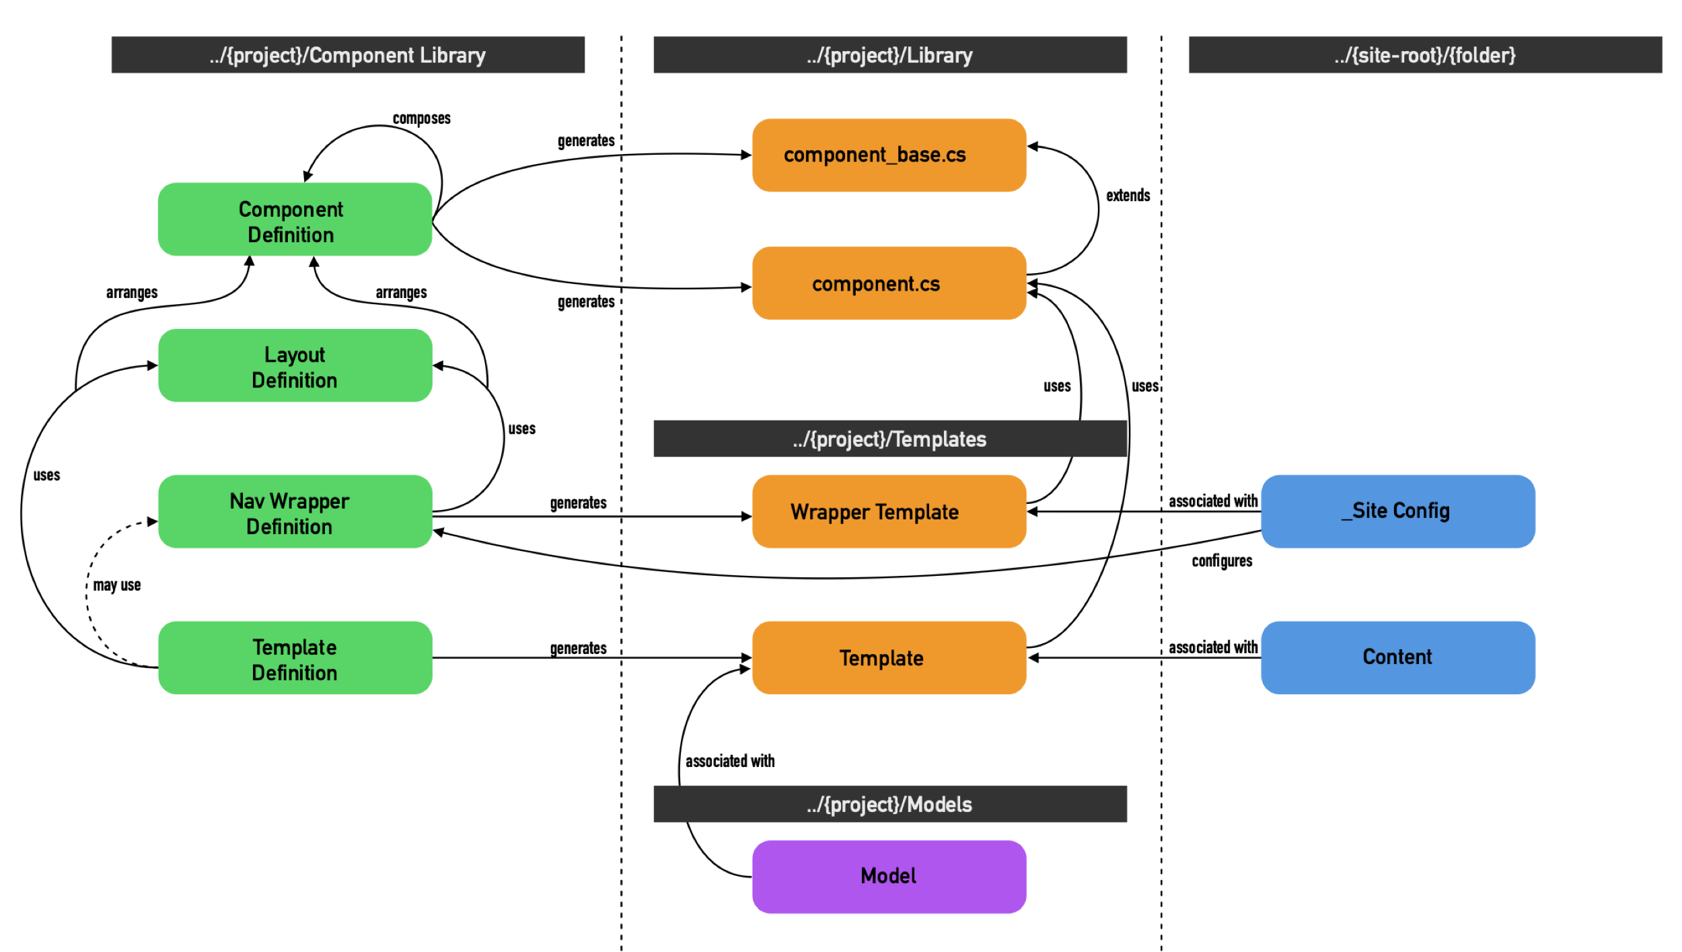
What is included in the Component Library?

Slide 12
Components in detail

Slide 13
Overview
The Component Definitions folder contains your site’s components
Components…
  are discrete items that are combined to make up your page
  can be reused on as many pages and templates as you need
  can – and usually do – contain other components
  are created based on your site’s design
  get built into C# class files when they are saved
  can be overridden with customized code to perform more complex tasks

Slide 14
Component Naming
Naming is important:
The parent folder name will be the section name in the drag-and-drop panel
The component name will appear in the drag-and-drop panel
Component Library generates a C# class name from the name
  Converts all text to lower-case
  Removes spaces and punctuation
  Applies initial capital
  Capitalises all letters that appeared after a space of punctuation

Slide 15


Component Naming
DO
Use spaces in the component name
Use user friendly / readable component names
Call To Action vs CallToAction
DON’T
Use the same name for the folder and the component
Use names that are C# reserved words, keywords or system classes
Common problem component names:
  class
  event
  date
  public

Slide 16
Component Naming Summary
Keep the name as descriptive and user friendly as possible
But remember the naming constraints!
«Header & Link – with CTA»
Good name or bad name?

Slide 17
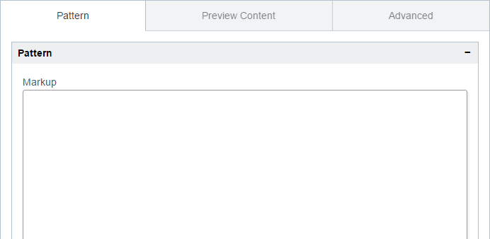
Creating a component definition
Create a component in the Component Definitions
folder
Use File > New > Component and enter a name
  It’s not easy to rename components, so choose carefully
Paste in your markup
Replace user-editable content with field definitions
Replace reusable markup fragments with sub-component references

Slide 18
Component markup
<div class="card" style="width: 18rem;">
<img src="..." class="card-img-top" alt="...">
<div class="card-body">
<h5 class="card-title">Card title</h5>
<p class="card-text">Some quick example text to build on the card title and make up the bulk of the card's content.</p> <a href="#" class="btn btn-primary">Go somewhere</a>
</div>
</div>
<div class="card" style="width: 18rem;">
{image: OptionalImage}
<div class="card-body">
<h5 class="card-title">{title:Text}</h5>
<p class="card-text">{body:Text}</p>
{cta:OptionalCtaButton}
</div>
</div>

Slide 19
Placeholders
Field and sub-component references must be in the form:
{name[:type]}
Name is required
You can repeat a field name in the markup if you need a copy of the markup to appear in multiple places.
The field type is optional – Component Library will default to using the Text component.
If provided, type must be the C# class name for the component

Slide 20
Field Naming
Naming is important:
Field names will be referenced in code: asset[“field_name”]
Field names become class variables in C#
  Must start with a letter
  Can contain letters, numbers and underscore
  Don’t use symbols: - + * @ $
  Cannot be a C# keyword
Component Library will replace dashes with underscores in the generated C# code – HOWEVER, we don’t recommend using field names like this as it can lead to collisions.

Slide 21
Field Naming
Component Library generates a default label for your field on the data entry panel by:
  Replacing underscores and dashes with spaces [EXCEPT LEADING UNDERSCORES]
  Converting to title case
Field | Label | Assessment
field | Field | +
field_name_with_parts | Field Name With Parts | +
_field | _field | - (CL does not generate a label)
field-name-with-parts | Field Name With Parts | - (Invalid C# identifier)
$field | n/a | - (Invalid C# identifier)
field with spaces | n/a | - (Invalid C# identifier)

Slide 22
Components in detail
Try to keep all your components at the same hierarchy level
  For example all inside a <div class=“column”>
Once you’re done, click Save
Refresh the view
Below the Markup field, you should see the Component Details panel

Slide 23
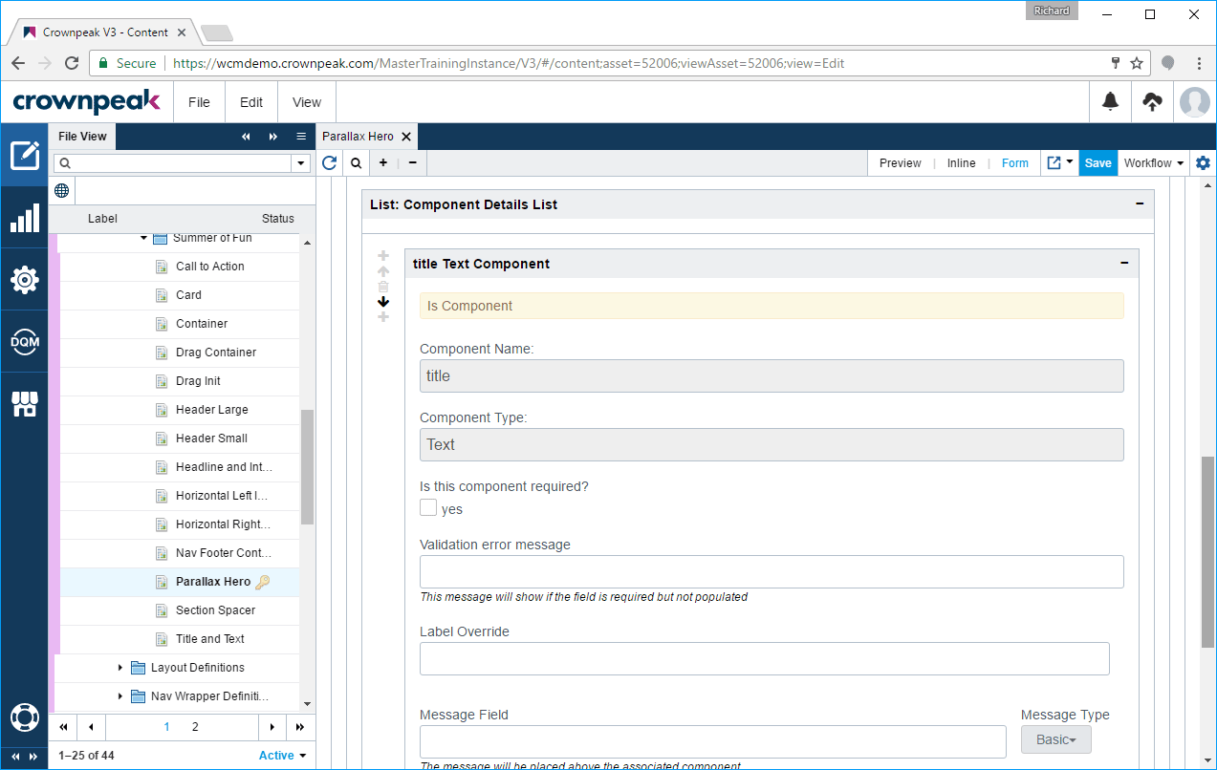
Components in detail

Slide 24
Components in detail
Here you can confirm and configure your components
Choose a Component Type for each component if you didn’t specify this in the pattern
Make the component required if a value must be provided
Change the label displayed for the component data entry field
Add a message above the component – this is useful for grouping fields

Slide 25
Components in detail
The first time you save, the Component Library creates two C# class files in the project Library folder
You can see the names of these classes on the Advanced tab
For example, if your component was called “Test”
  Components_TestBase.cs
  Components_Test.cs
Never edit the “Base” class – this is regenerated on each save

Slide 26
Components in detail
The other class is available for you to edit to customize your component’s behavior
Put logic in here to supplement or replace:
  ComponentInput() – for the input experience
  ComponentPostInput() – custom validation run when the user clicks Save
  ComponentOutput() – control exactly what your control outputs
Wrap or replace the base method call depending on your requirements

Slide 27
Layouts in detail

Slide 28
Overview
The Layout Definitions folder contains your layouts
Layouts…
  provide additional HTML markup to position and structure your components
  specify ”slots” into which you can place components
  are reused a lot
  are the glue that sticks your components together
  are not built into classes, but processed when a template is used

Slide 29
Layouts in detail
Use File > New > Layout and enter a name
  Enter markup – use {coln} for your slots (columns)
  <div class="row">
  <div class="col col-md-8">{col1}</div>
  <div class="col col-md-4">{col2}</div>
  </div>
NOTE: if you target multiple components in a slot, the component markup will be placed sequentially

Slide 30
What is included in the Component Library?
Page
No Rail layout
  shows your component markup unaltered
  good choice for full-width items
  most common choice when building a page
Layout wraps component markup with extra markup
Most common framework is Twitter Bootstrap
  e.g. col-md-6 col-md-6
Make as many layouts as your site needs
No Rail Layout
Component
Half and Half Layout
Component
Component

Slide 31
Layouts in detail
Up to four columns are allowed in each layout
Select which column to use when placing a component on a template
As with components, try to keep your layouts at the same level
  For example, all inside <div class=“container”>
NOTE: you can create a null layout that doesn’t specify any slots – useful when you don’t want output as with configuration components

Slide 32
Wrappers in detail

Slide 33
Overview
Wrappers Definition are used to generate nav-wrapper templates
As a reminder, nav-wrapper templates
  include common navigational and boilerplate elements
  are often the same across all pages
  help to ensure the consistency of your site
  are built into CMS templates when they are saved

Slide 34
Wrappers in detail
Create a Wrapper in Component Library/Nav Wrapper Definitions
Use File > New > Wrapper and enter a name
Enter sections
  Sections go in the Header or the Footer of the page
  Each section has a layout – use “no rail” if you don’t need markup
  Each section corresponds to a tab on the Site Configuration template
  Sections can contain one or more components
  Input-only components are useful here – see Advanced Components

Slide 35
Wrappers in detail
Create a Wrapper in Component Library/Nav Wrapper Definitions
Use File > New > Wrapper and enter a name
Enter sections
  Sections go in the Header or the Footer of the page
  Each section has a layout – use “no rail” if you don’t need markup
  Each section corresponds to a tab on the Site Configuration template
  Sections can contain one or more components
  Input-only components are useful here – see Advanced Components

Slide 36
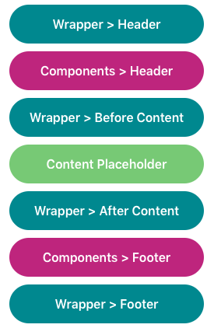
Components in wrapper

Slide 37
Wrappers in detail
Note: you don’t have to use the Nav Wrapper Definition
  You can still create a nav-wrapper manually
  This is useful if you have more advanced requirements
If you want to create an ASP.NET master page, or a Java Tag page
  Create a new template manually
  Output placeholders or tag markup as required
  Call back to a template created with Nav Wrapper Definition for preview
  Don’t forget to update your template if the original changes
Strongly recommend this approach
  Otherwise you have to republish every page if your navigation or config changes

Slide 38
Templates in detail

Slide 39
Overview
The Template Definitions folder contains Templates
Templates…
  use Components and Layouts to create CMS templates
  take care of the input, validation and output experience for you
  use Wrappers to render the final output to the page
  get built into CMS templates when they are saved
  DO NOT make filename, url, search_g2_*, etc. templates for you
    You need to add these after you build each template

Slide 40
Templates in detail
Create a Template in Component Library/Template Definitions
Use File > New > Template and enter a name
Enter sections
  Each section has a layout – use “no rail” if you don’t need markup
  Each section corresponds to a tab on the Input template
    In Customize you can also choose to continue on the previous tab
    Useful for controlling the input experience
  Sections can contain one or more components
  Choose which column to use for your component based on the layout
  Enter a message to show above the component if the page is complex

Slide 41
Templates in detail
On the Wrapper tab, choose the wrapper to be used for this template
  If you manually create a nav wrap, choose Custom Built Wrapper
On the Settings tab, make sure Create is checked
Provide a name for your new template
Select Component Project/Templates as the folder to use
Check “Enable Page Metadata” to get meta tags for SEO

Slide 42
Templates in detail
Click Save to create your template
This creates a new template: input.aspx, post_input.aspx and output.aspx
Look, but don’t touch – changes will get overwritten without warning
You should add filename.aspx and url.aspx to your template
  Copy from any other template
  These ensure your asset has a consistent file name when published
  Other template files may also be copied as required
Create a model using your new template and apply it to a folder
  Models go in Component Project/Models

Slide 44
Where is the Component Library?

Slide 45
Where is the Component Library?
Depends on your site and content strategy
Usually has one installation per site
  Works well with Crownpeak’s “Sites and Projects”
  Usually contained within the Component Project folder inside the Site Root
Only your developers need to have access to this folder
Content authors do not need to interact with the Component Library directly
  They work with the templates that you create using it

Slide 46
Where is the Component Library?
Version 2.1 is now available, and will be used for all of your sites
Version 2 uses code held in our Services Library
  Faster to set up and configure
  Supports Project Branching so updates to components can be managed
  Supports Drag and Drop page design
    Scheduled for general availability in Q3

